Slide 1
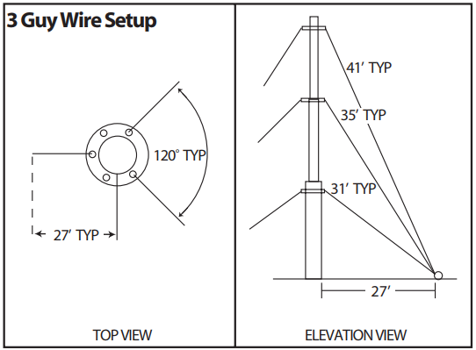
Knots and Ropes in Amateur Radio
Anthony A.T. Mendina, NT5TM
Notes:
1

Slide 2
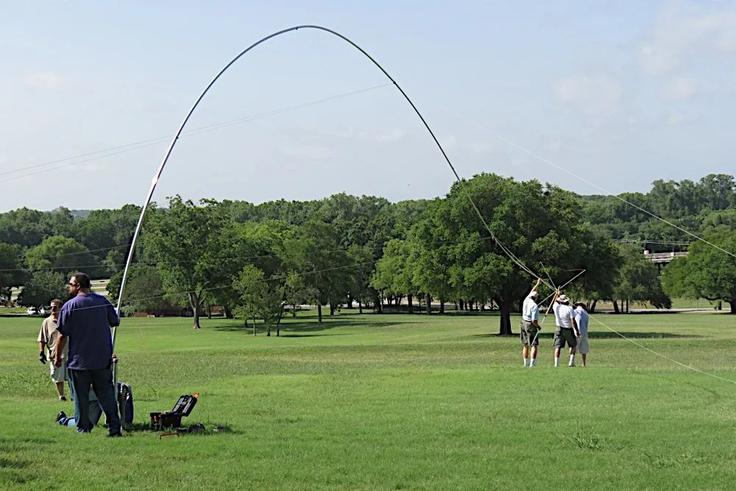
Rope: What’s it good for?
Field Day.
Wire Antennas.
Light-duty permanent structures, e.g. push-up poles..
Larger permanent structures—with engineering assistance.
<number>
Notes:
2

Slide 3
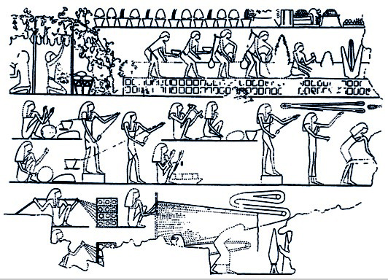
Why rope and not just steel cable?
Easy to work with, no special tools or clamps.
Inexpensive (not for the best stuff!).
Commonly available (be careful!).
Doesn’t rust.
Doesn’t conduct electricity when dry!
Familiar—large base of experience and skills.
<number>
Notes:
3

Slide 4
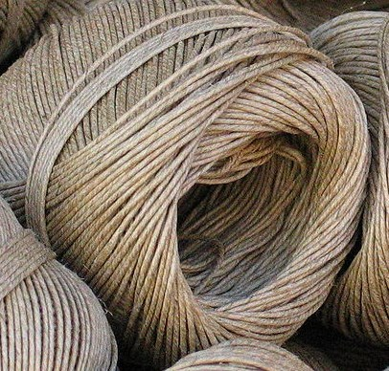
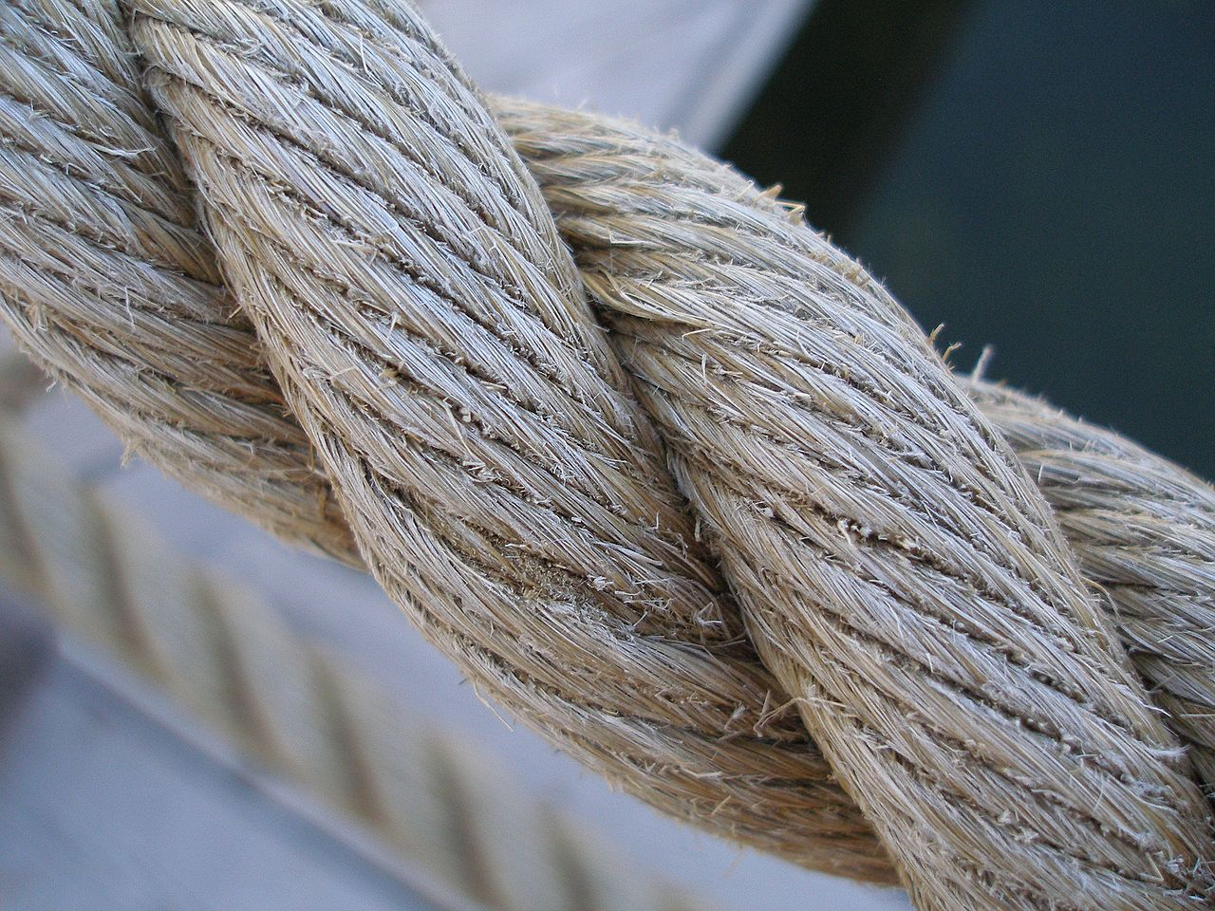
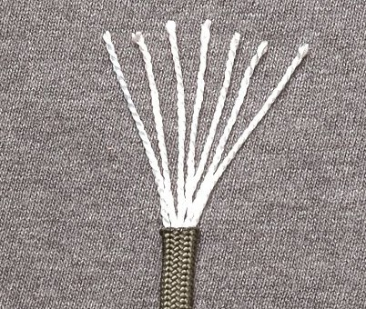
Common Types of Rope
Twine and Cord
No particular structure.
Often surprisingly weak.
Slingshot or potato gun line.
Laid (Traditional) Rope
Natural fibers twisted and coiled together.
All fibers contribute strength.
Hemp, cotton, jute, sisal.
Also plastic imitations for marine use.
Kernmantle Rope
Braided protective cover.
Inner fibers for strength.
All modern, high-strength ropes: climbing, parachute cord.
<number>
Notes:
4

Slide 5
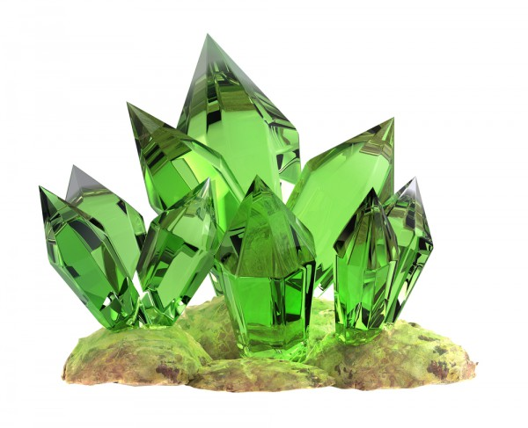
Weaknesses
Natural Fibers
Often weak—especially jute.
Good hemp rope is hard to get!
Fungus and bacteria.
Water.
Shock sensitive.
Many chemicals.
pH changes.
Abrasion.
Synthetic Ropes
Heat.
UV light—especially the cheaper ropes.
Abrasion, though less vulnerable.
Not water—many are soaked on purpose before first use.
All Ropes
Knots and sharp turns.
Short, sharp shock.
User error.
<number>
Notes:
5

Slide 6
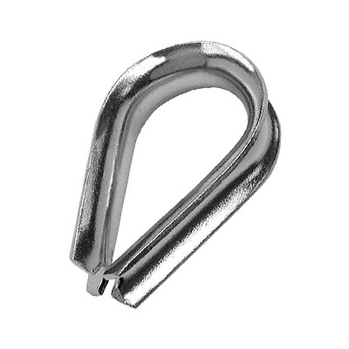
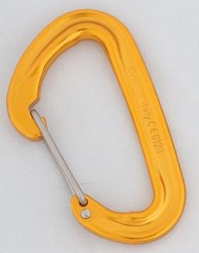
Safe Use
For permanent use, look for the newer products made of “Spectra” or “Dyneema” (UHMWPE).
Cut only as directed—heat, not a knife, if specified.
Polyester (dacron) is the 2nd choice—think paracord.
Use clamps and thimbles for permanent use.
Avoid most rope at home improvement stores except for temporary, light-duty use.
Choose only U/V resistant types except for temporary use.
Minimize friction.
Chain.
S-hooks.
One rope to tree, 2nd to antenna.
Covers/shields.
Carabiners.
Thimbles.
<number>
Notes:
6

Slide 7
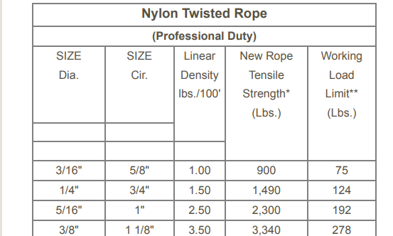
Safe Use
Remember, knots weaken rope! And some knots fall apart.
Use a bowline or a figure-8, and avoid the square knot.
Working load is usually 1/5 of breaking strength for temporary, improvised use...sailors often use 1/12!
Working load is usually 1/3 of breaking strength for permanent, planned use with loads calculated and no shocks.
Stay out of line with loaded rope!
Plan for movement or plan for failure—counterweights, springs, break-links, and (for thick ropes) pulleys can all help.
<number>
Notes:
7

Slide 8
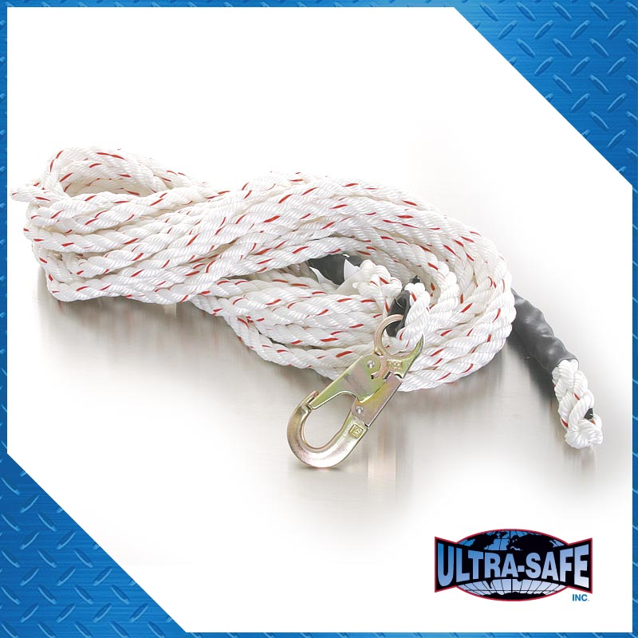
Let’s tie a few knots!
Remember that knots are temporary and weaken the rope.
Professional use is moving away from knots altogether.
<number>
Notes:
8

Slide 9

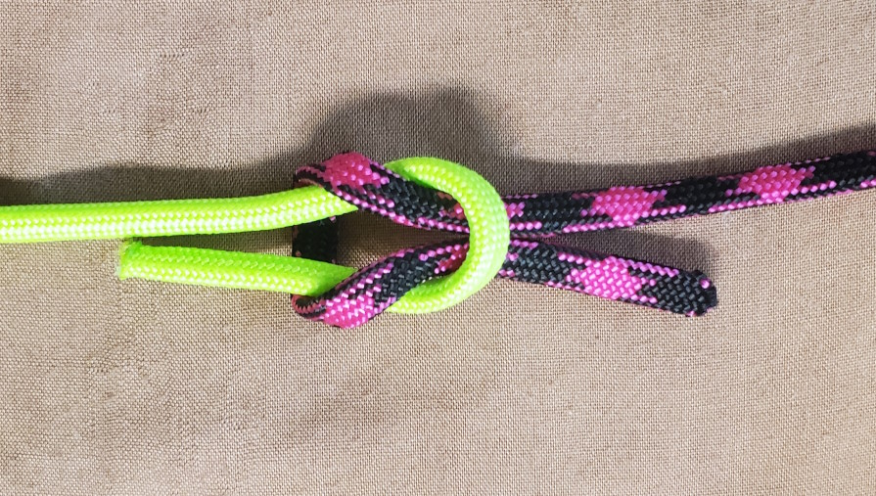
The best knots and the worst knots
Square knots are only for things you want to fall apart.
The bowline and the figure 8 are great.
A fun reference: animatedknots.com.
https://animatedknots.com
<number>
Notes:
9

Slide 10

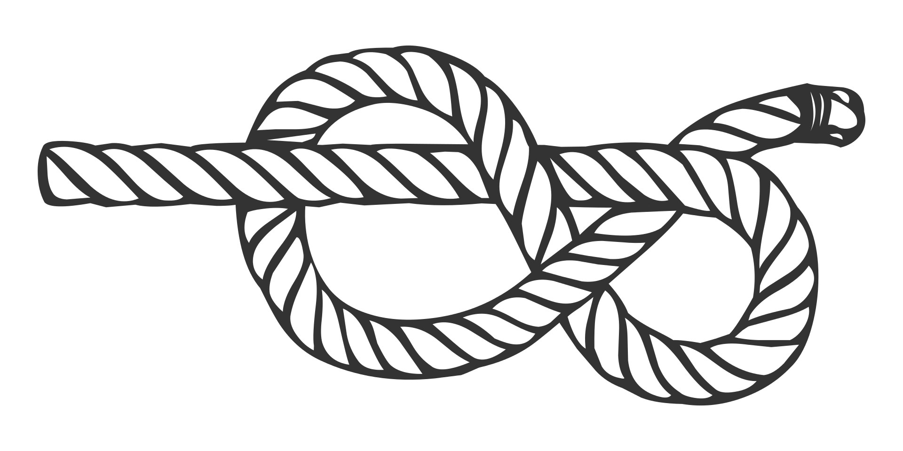
Figure-Eight
A simple stopper knot.
The basis of the Figure-Eight Bend and Figure-Eight Loop.
https://www.animatedknots.com/figure-8-knot
<number>
Notes:
<number>

Slide 11
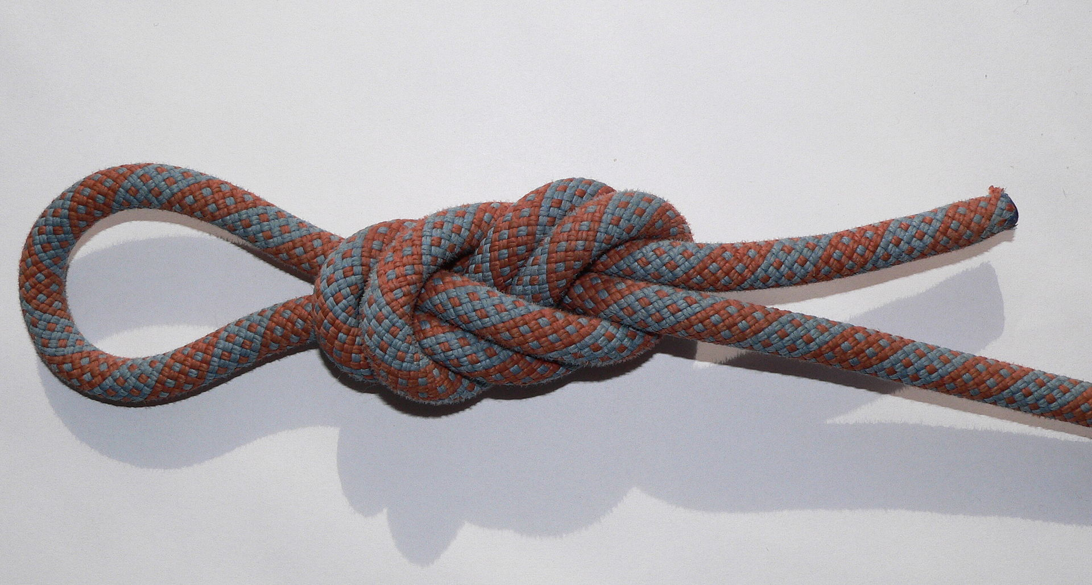
Figure-Eight Loop
Basis of the strongest-known loop (double figure-8 or figure-9).
Try to tie it on your own before we move on to the next slide.
<number>
Notes:
<number>

Slide 12


Figure-Eight Loop
Two common ways to tie: follow through or on a loop
Loop version is extremely strong when given an extra half-twist
https://www.animatedknots.com/figure-8-follow-through-loop-knot
https://www.animatedknots.com/figure-9-loop-knot
<number>
Notes:
<number>

Slide 13
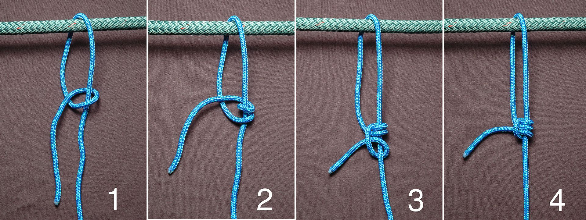
Taut-Line Hitch
Field day special! Adjustable!
Must be kept tight; not for permanent use.
Several variations; you can also add more loops in step 2.
https://en.wikipedia.org/wiki/Taut-line_hitch
<number>
Notes:
13

Slide 14


Taut-Line Hitch
https://en.wikipedia.org/wiki/Taut-line_hitch
I prefer variation #1857 because it’s easiest to untie after heavy use.
https://www.animatedknots.com/midshipmans-hitch-knot
Animatedknots.com dislikes my favorite form because it’s not ready to use until you’re done tying it.
<number>
Notes:
14

Slide 15
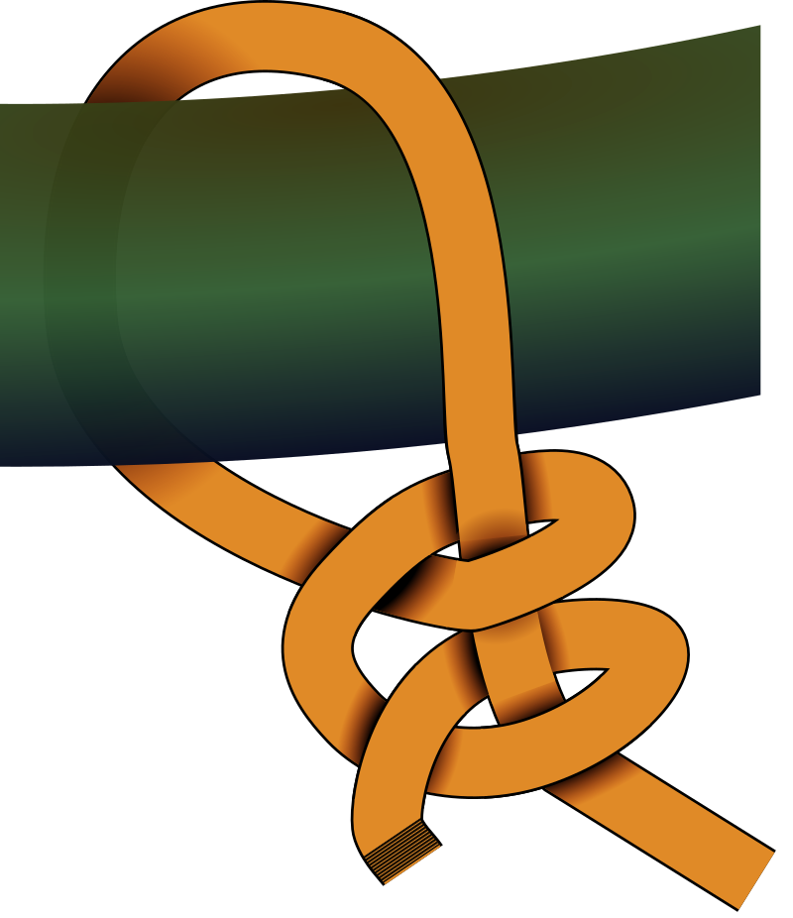

Two Half Hitches
Attaches a rope to a tree or a pole, even under load!
Tightens itself and stays secure.
You can use any number of “round turns” to lower the strain on the knot itself.
https://www.animatedknots.com/round-turn-two-half-hitches-knot
By Sawims at Dutch Wikipedia
<number>
Notes:
<number>

Slide 16
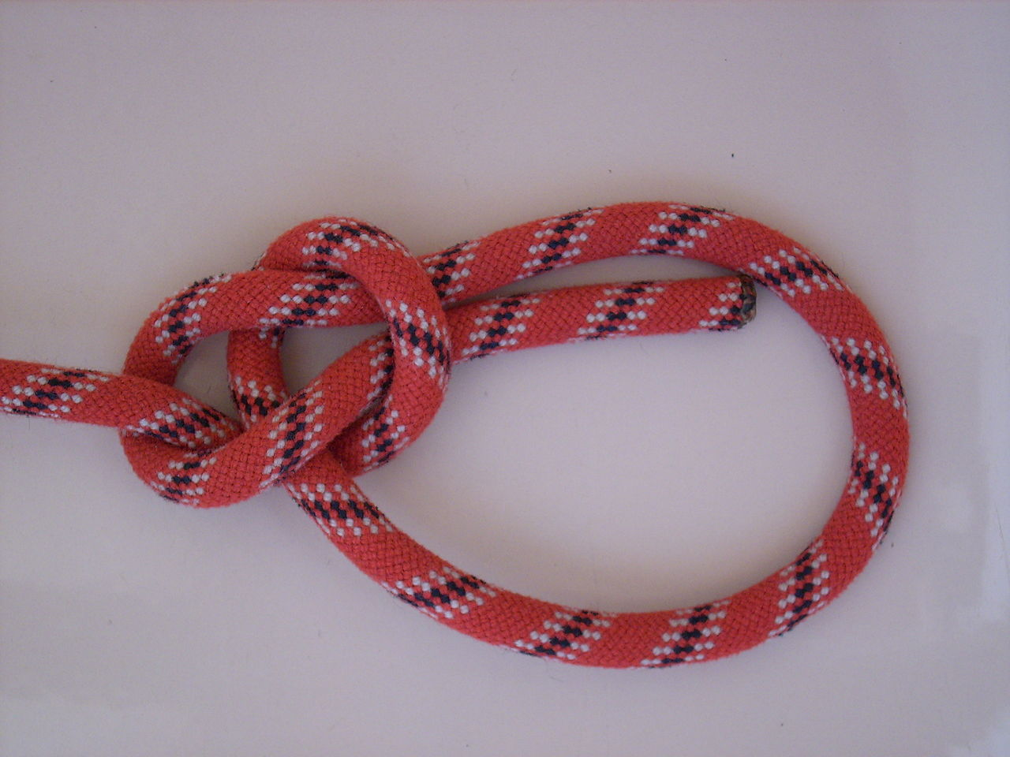

Bowline
For human weight, figure-8 family is stronger & safer.
Great for any loop that needs to stay put ...but secure the loose end! ...this knot can fall apart!
Can even join ropes.
https://www.animatedknots.com/bowline-knot
<number>
Notes:
16

Slide 17
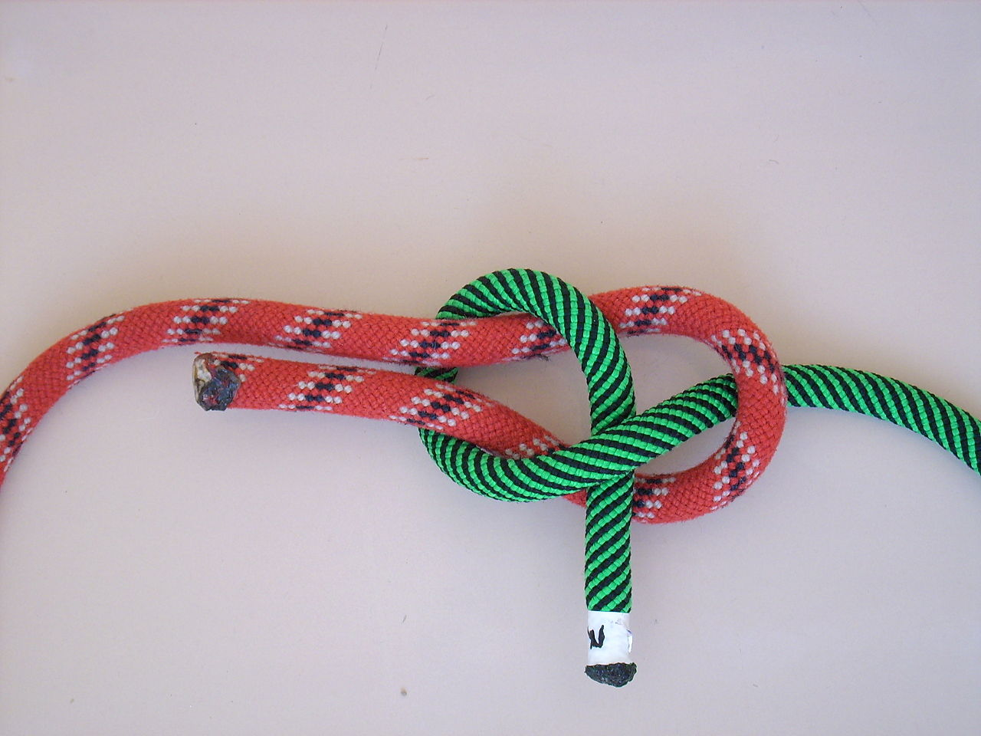

Sheet Bend
Join unequal size lines, e.g. twine and paracord.
Leave the ends much longer than this!
Consider two loops, e.g. two bowlines, or a figure-8 bend.
https://www.animatedknots.com/sheet-bend-knot
<number>
Notes:
17

Slide 18
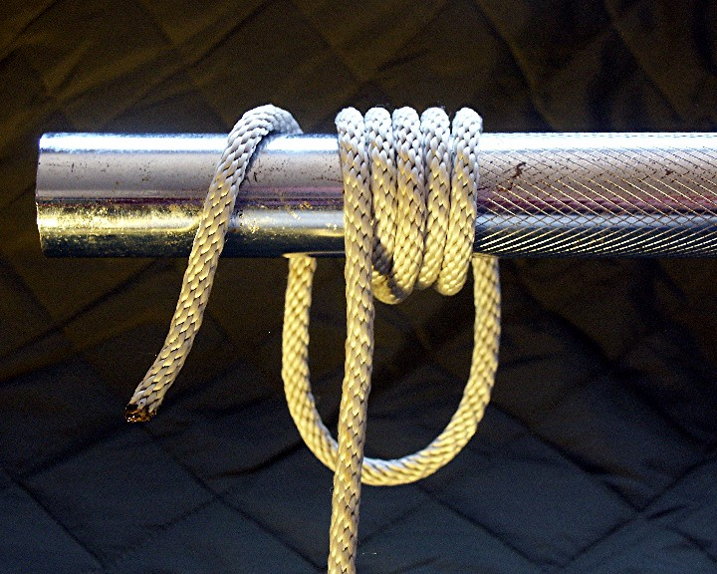
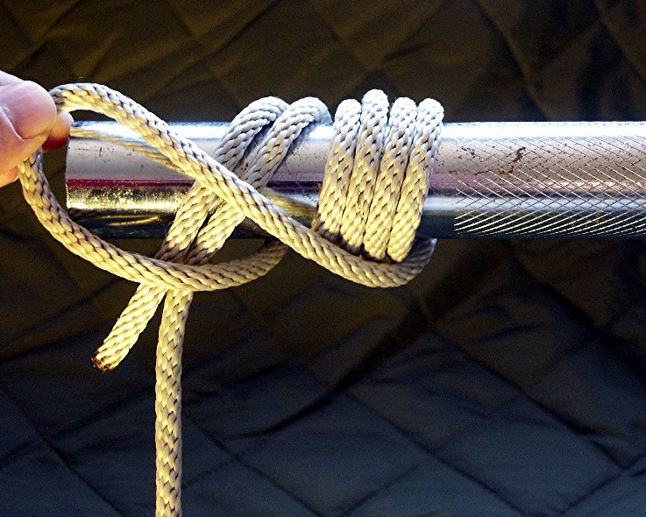
BONUS: Icicle Hitch
Hold on to anything: an antenna, a metal spike, even an icicle!
Notice the round turns?
https://en.wikipedia.org/wiki/Icicle_hitch
<number>
Notes:
18

Slide 19


BONUS: Icicle Hitch
Two ways to tie. Bookmark them for later!
https://www.animatedknots.com/icicle-hitch-knot-loop-method
https://www.animatedknots.com/icicle-hitch-knot-end-method
<number>
Notes:
19

Slide 20
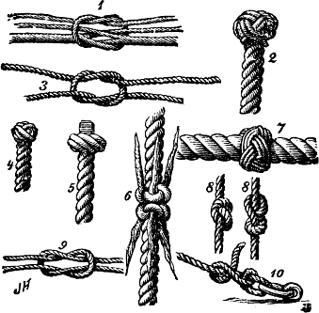
What are your favorite knots?
How many Eagle Scouts do we have here today?
Thank you for coming out today! Let’s play!
<number>
Notes:
20

